Slide 1

Multi-model KG using ARANGODB & AQL
Batch – 1 (SAI TANUSHA) – TECH PIRATES

Slide 2
Extraction
Qwikidata is a python package with tools that allow you to interact with wikidata.The package defines a set of classes that allow you to represent wikidata entities in a pythonic way. It also provides a pythonic way to access three data sources,
1) linked data interface
2) sparql query service ---------- (IMPLEMENTED)
3) json dump ---------- (IMPLEMENTED)

Slide 3
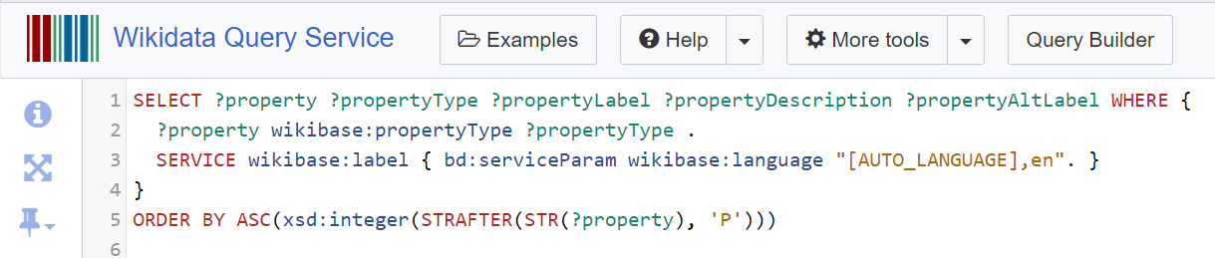
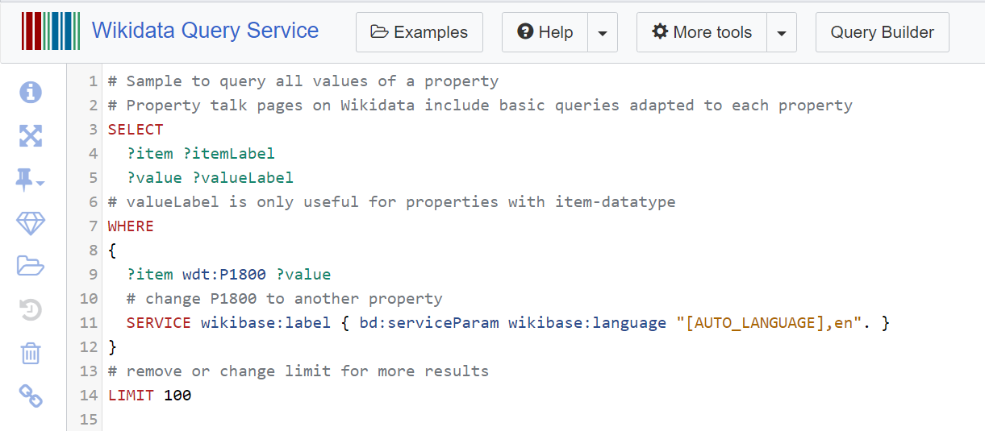
SPARQL
Property collection
Item collection containing single property
Let’s us describe data using a collection of three parts statements:
Row Identifier – (subject)
Column Name – (predicate)
Value – (Object)

Slide 4
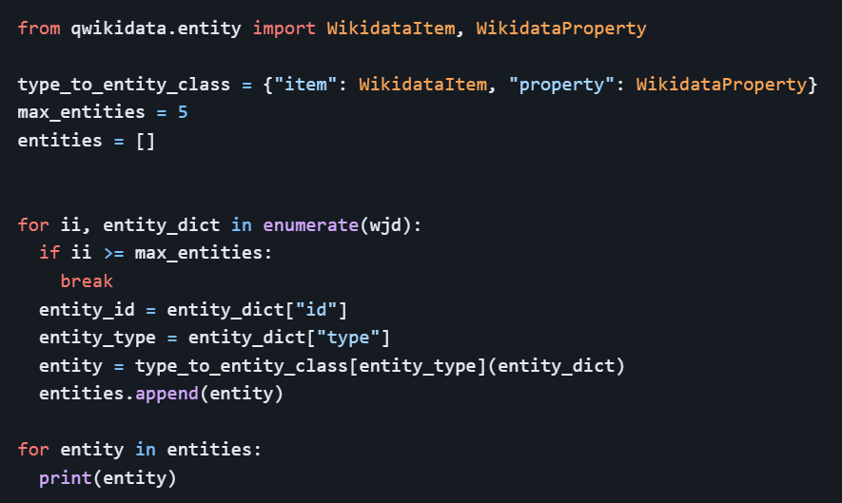
Qwikidata & pyarango
Property collection - WikiProps
Item collection - WikiItems
Edge Collection - WikiEdge
3685 – items in formed WikiItems Collection
284 – properties in WikiProps Collection
12,648 – edges in WikiEdge Collection

Slide 5
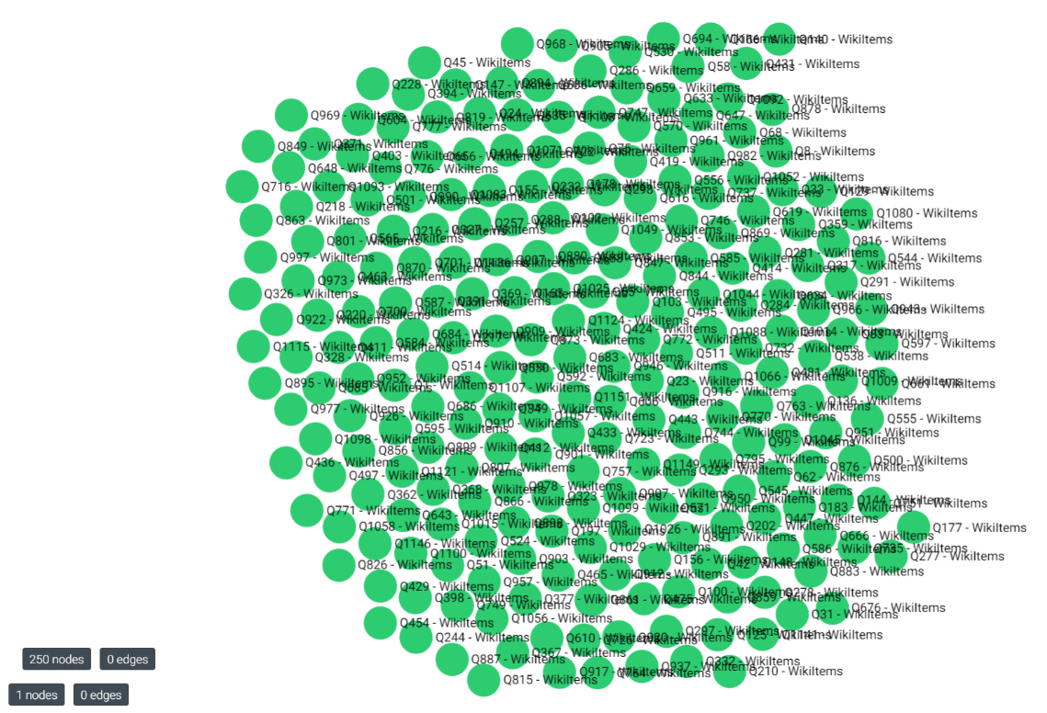
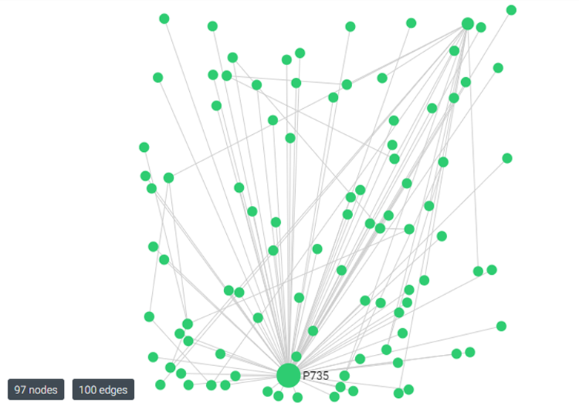

Slide 6
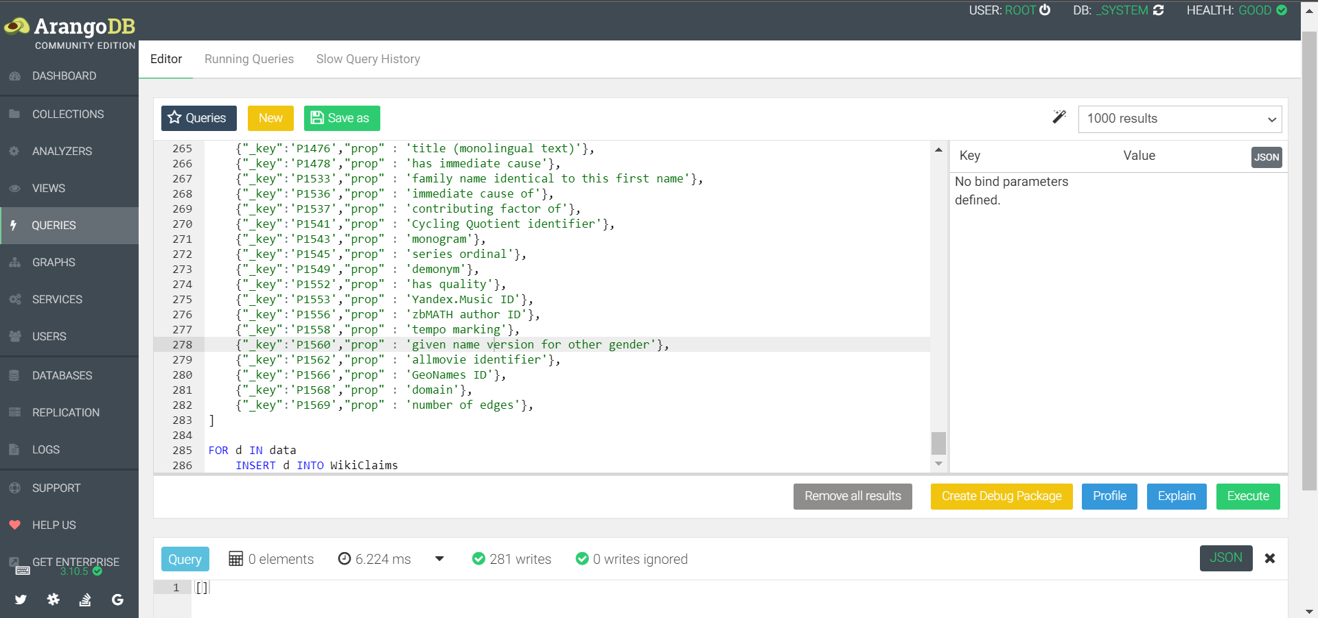
VIEWS

Slide 7
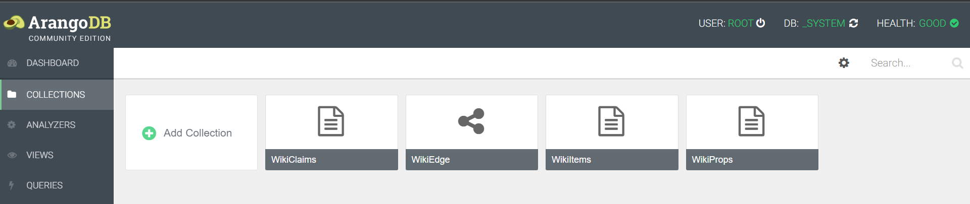
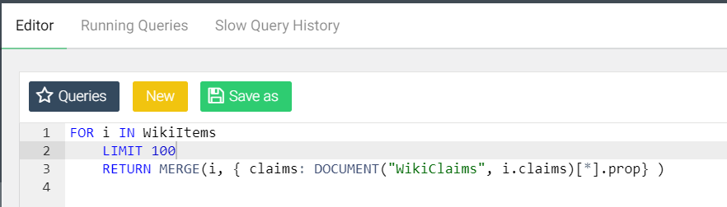
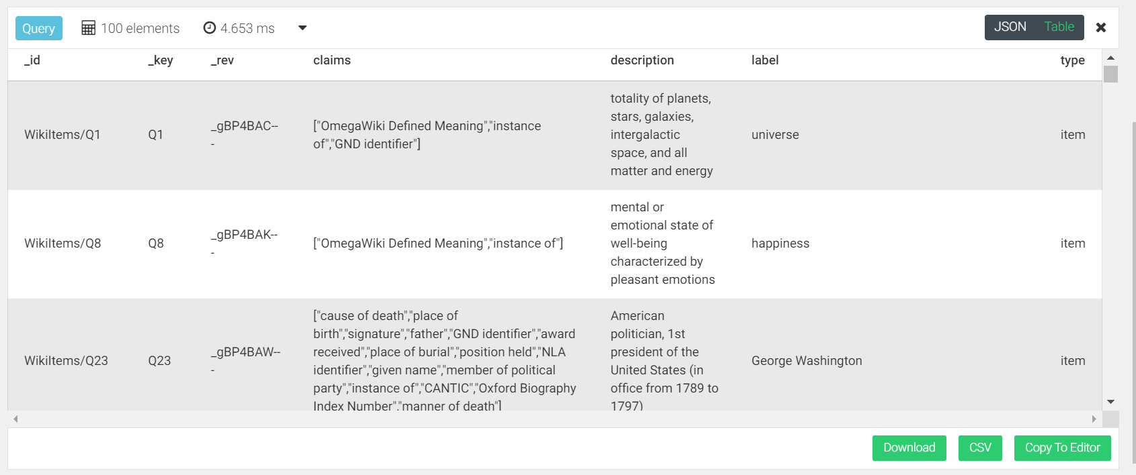
Question 1
Find the instances of all the items collectively and extract the result in the form of json file.

Slide 8
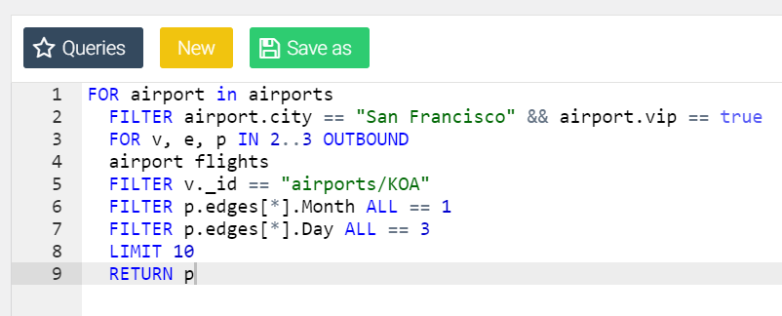
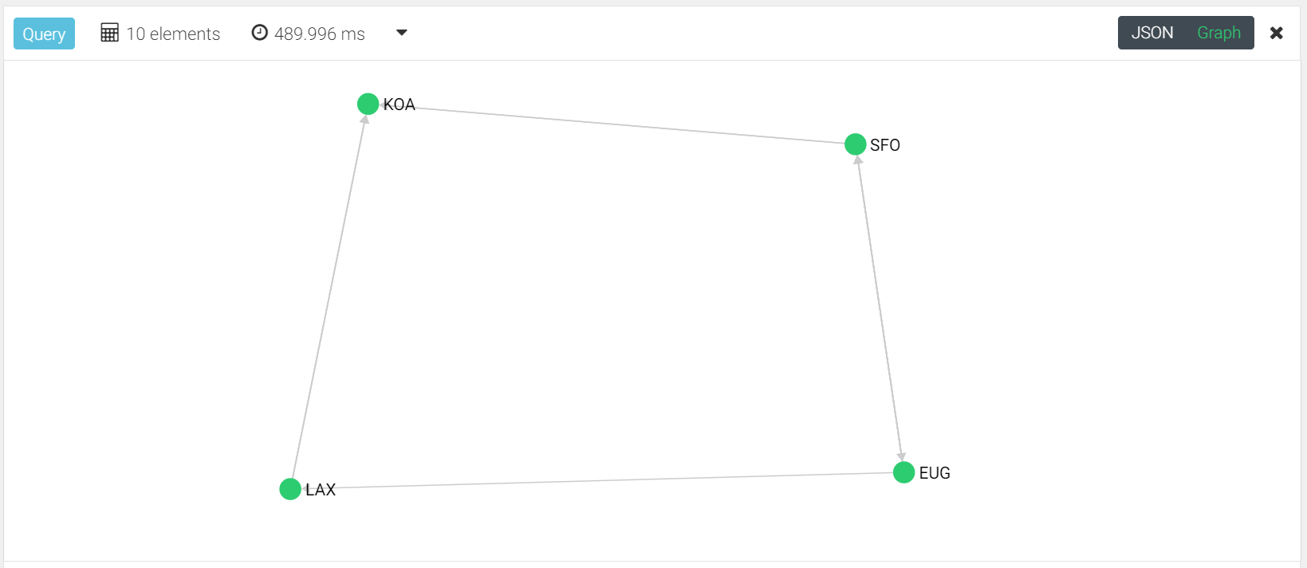
Question 2
Using 3 Edge collections and with a minimum of 2 hops and a max of 3 hops between the airports find the path in the form of a graph.

Slide 9
Summary
Downloaded the Wikidata dump in JSON format
Formed 2 document & 1 edge collections
Created a VIEW / Claim collection
Queried a graph using the collections
Implemented AQL queries on 2 instances

Slide 10
Thank you

